Slide 1


K.RAMAKRISHNAN COLLEGE OF TECHNOLOGY (AUTONOMOUS), TRICHY
US STOCK RISK ANALYZER USNIG MACHINE LEARNING
 | PRESENTED BY, JEEVA M (811721243019) SHANKARANARAYANAN R (811721243051) THINESH M (811721243059) HARISH GOKUL M (811721243301)
GUIDED BY,
Ms. MA.REETA JAYARANI, M.E.,Ph.D,
ASSISTANT PROFESSOR / AI
1

Slide 2
OBJECTIVE
Machine learning is increasingly used in US stock market analysis to predict trends, optimize portfolios, and manage risk. By analyzing large datasets, such as historical stock prices and market sentiment, machine learning models can identify patterns and make data-driven predictions. While powerful, challenges like data quality and market unpredictability remain. Nonetheless, ML continues to enhance trading strategies and investment decisions.

Slide 3


EXISTING SYSTEM
Currently there are traditional risk assessment methods that uses methods like value at risk and Beta Coefficient.
Early methods were limiting in their ability asses real-time risk assessment.
While this Traditional methods provide some level of insight, it is highly time-consuming, subjective, and impractical for large-scale applications.

Slide 4
PROPOSED SYSTEM
Data Collection and Preprocessing: Resizes, normalizes, and denoises grayscale images for better feature extraction from stock market data and sentiment data.
Feature Engineering: Identify key features such as moving averages, relative strength index (RSI), volatility, and trading volume to enrich the dataset.
Model Development: Use linear regression or more advanced models like Random Forest or LSTM to predict future stock prices based on historical data.
User Interaction: Provides downloadable results, evaluation metrics (SSIM, PSNR), and API integration for real-time applications.

Slide 5
LITERATURE SURVEY
S. No | Title | Year | Description | Algorithm | Merits | Demerits
1. | STOCK MARKET ANALYSIS USING MAPREDUCE AND PYSPARK | 2021 | The study particularly focuses on the role of risk aversion and economic conditions in influencing stockholding behavior. | Probit regression model Fairlie's Non-linear Decomposition Technique | Uses robust statistical decomposition to quantify contributing factors like education, credit constraints, net worth, etc. | Risk preference is assessed subjectively, not via actual investment decisions.
2. | IS THERE A BANKING RISK PREMIUM IN THE US STOCK MARKET? | 2020 | examine whether a banking risk premium, constructed based on bank size, is priced in the US stock market, particularly in the context of the CAPM and Fama-French three-factor models. | CAPM (Capital Asset Pricing Model) Augmented Fama-French model with a banking factor (BNK) | Uses U-Net for accurate color segmentation. | The model's performance heavily depends on the diversity and quality of the training dataset.

Slide 6
LITERATURE SURVEY
S. No | Title | Year | Description | Algorithm | Merits | Demerits
3. | APPLICATIONS OF ARTIFICIAL INTELLIGENCE IN THE ECONOMY, INCLUDING APPLICATIONS IN STOCK TRADING, MARKET ANALYSIS, AND RISK MANAGEMENT | 2019 | The paper surveys and analyzes LIME (Local Interpretable Model-agnostic Explanations) and other related algorithms used to explain predictions made by machine learning models, focusing on interpretability and explain ability of black-box models. | SHAP (SHapley Additive exPlanations) Saliency maps Partial Dependence Plots (PDP) Anchors DeepLIFT | Model-agnostic: Works with any machine learning model. Local fidelity User-friendly Modular: Can be combined with different types of models and data. | Instability Approximation Computationally Expensive Not global
4. | STOCK MARKET FLUCTUATIONS AND CONSUMPTION BEHAVIOUR : SOME RECENT EVIDENCE | 2019 | It provides comparative analysis of AI algorithms and models used in financial contexts and evaluates their accuracy, limitations, and suitability for economic tasks | Bayesian Regularization Social Spider Optimization (SSO) Genetic Algorithm (GA) Long Short-Term Memory (LSTM)​ | High prediction Real-time adaptability Enhanced return performance Applicable across domains | Accuracy decay over time Model complexity Limited long-term forecasting Dependence on data quality
2

Slide 7
LITERATURE SURVEY
S. No | Title | Year | Description | Algorithm | Merits | Demerits
5. | Non-linear Decomposition Analysis of Risk Aversion and Stockholding Behavior of U.S. Households | 2017 | predict stock price movement by combining: Stock Volatility Analysis using Hadoop MapReduce and PySpark Machine Learning (MLlib) | MapReduce (Hadoop) LSTM (Long Short-Term Memory) Decision Tree Regressor (PySpark MLlib) Preprocessing Tools | Achieved 70.59% accuracy custom sentiment dictionary Effective use of Big Data (MapReduce, PySpark) | Limited generalization Overfitting risk Sector-specific sentiment dictionary may not generalize well beyond use-case

Slide 8
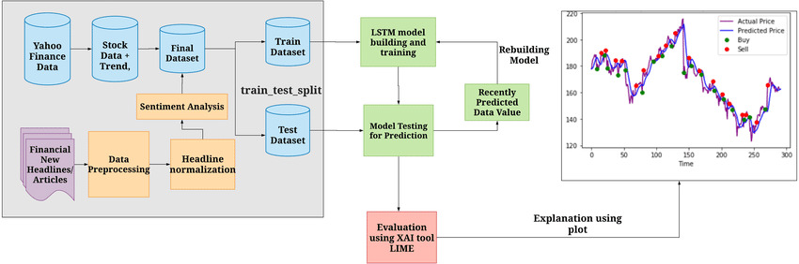
ARCHITECTURE DIAGRAM

Slide 9

SYSTEM SPECIFICATION
HARDWARE SPECIFICATION:
Computer - minimum of 8GB RAM & Intel Core i5 or equivalent processor, 256GB of storage.
NVIDIA GPU for faster model training
Additional Sensors – only if required like light sensors, Bio metric sensors, Temperature Sensor.
Ethernet/Wi-Fi Adapter.
SOFTWARE SPECIFICATION:
Operating system - Windows, Linux, or MacOS.
Python libraries such as – Scikit-learn, LightGBM, Pandas, NumPy, Matplotlib, Yahoo finance, Flask.
API Services - Yahoo Finance API – for real-time stock data extraction
Dataset Source Used – Kaggle Books Dataset
HTML/CSS or JavaScript - for UI design.

Slide 10
MODULES
Installation and Setup
Data Preprocessing and Feature Extraction
Model Development and Forecasting
Evaluation and Visualization
Web Integration and Deployment

Slide 11
INSTALLATION AND SETUP MODULE
This module establishes the technical foundation of the US Stock Market Analysis System. It begins with setting up the required development environment and installing essential libraries such as pandas, numpy, yfinance, matplotlib, seaborn, scikit-learn, Tensorflow, and flask. These libraries play critical roles in data handling, analysis, visualization, and building the web interface.Following the installation, the system is configured to fetch historical data for selected US stocks using the yahoo finance API. This module ensures a smooth beginning for the entire system pipeline, enabling further preprocessing, analysis, and model development.

Slide 12
DATA PREPROCESSING AND FEATURE EXTRACTION
This module focuses on preparing the raw stock data for machine learning applications. Preprocessing steps include handling missing values, outlier treatment, normalization, and formatting time-series data. Special attention is given to converting dates into a suitable datetime format and creating lag features to preserve temporal integrity.
Feature engineering techniques are then applied to extract additional meaningful insights. Indicators like Moving Averages, RSI (Relative Strength Index), MACD (Moving Average Convergence Divergence), and Bollinger Bands are calculated and included in the dataset. These features enrich the model’s learning capability by capturing underlying patterns and market behavior.

Slide 13
MODEL DEVELOPMENT AND FORECASTING MODULE
This module is the core of the project, where machine learning and deep learning models are implemented. Models such as Linear Regression, Random Forest, and LSTM (Long Short-Term Memory) are trained on historical stock data to predict future stock prices or trends.
LSTM models, in particular, are used due to their effectiveness in capturing time-dependent relationships in sequential financial data. The training process includes data splitting, normalization, and reshaping into 3D format (for LSTM). The models are optimized using techniques like cross-validation, hyper parameter tuning, and early stopping. This module enables the system to provide accurate predictions based on learned historical patterns.

Slide 14
EVALUATION AND VISUALIZATION MODULE
This module evaluates the model’s performance using statistical metrics such as MAE (Mean Absolute Error), RMSE (Root Mean Square Error), and R² Score. These metrics help assess the model’s ability to generalize to unseen data. For classification-based predictions, precision, recall, and F1-score are also considered.
Additionally, visualizations are created using matplotlib, seaborn, and plotly to offer intuitive understanding of trends, predictions, and actual values. Charts like line plots, candlestick charts, and correlation heatmaps are used to communicate results effectively. This module ensures that both performance and clarity are maintained in the system output

Slide 15
WEB INTEGRATION AND DEPLOYMENT MODULE
This module integrates the machine learning system with a user-friendly web interface developed using Flask. Users can input a stock symbol and date range to retrieve forecasted trends and analysis results through a clean HTML/CSS interface. Backend functions handle data retrieval, preprocessing, prediction generation, and visualization display.
The trained models are serialized using joblib or pickle and are loaded dynamically without retraining. Finally, the entire system is prepared for deployment on cloud platforms like Heroku or AWS, ensuring accessibility and scalability. This module bridges technical implementation with end-user interaction, making the stock market analysis accessible to non-technical users.

Slide 16
ADVANTAGES
Real-Time Data Access
Accurate Risk Classification
Comprehensive Technical Indicators
User-Friendly Interface
Automation and Integration
Yahoo Finance integration.
Cross-Platform Deployment

Slide 17
APPLICATION
Predicting stock trends using historical price data.
Optimizing investment portfolios with machine learning.
Managing financial risk through data-driven insights.
Analyzing market sentiment for better predictions.
Identifying hidden patterns in trading behaviour.
Enhancing algorithmic trading strategies and decisions.

Slide 18
CONCLUSION
The US Stock Market Analysis Using Machine Learning project successfully demonstrates how machine learning can be leveraged to analyze, interpret, and forecast stock market behavior. By integrating real-time financial data with powerful algorithms like LightGBM and LSTM, the system effectively classifies stock risks and provides insightful predictions supported by technical indicators.

Slide 19
REFERENCE
1. Liujing Zeng; Robert Faff; "Is there a Banking Risk Premium in the US Stock Market? “ IEEE-2020
2. Majid Haghparast, Wei-Che Chang:“Applications of artificial intelligence in the economy, including applications in stock trading, market analysis, and risk management” IEEE-2019
3. Laurence Boone, Claude Giorno."STOCK MARKET FLUCTUATIONS AND CONSUMPTION BEHAVIOU” Organization for Economic Co-operation and Development-2019

Slide 20
REFERENCE
4. Marimuthu Muthuvel, Palaniswami "STOCK MARKET ANALYSIS USING MAPREDUCE AND PYSPARK” International Research Journal of Modernization in Engineering Technology and Science-e-ISSN: 2582-5208
5. M. Humayun Kabir, shamim shakur; Gaurav Raj,"Non-linear Decomposition Analysis of Risk Aversion and Stockholding Behavior of U.S. Households"Morningstar, 2017- JEL:G11,G14

Slide 21
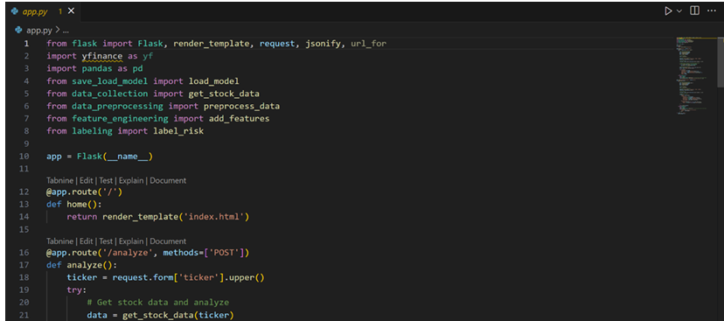
SCREENSHOTS

Slide 22
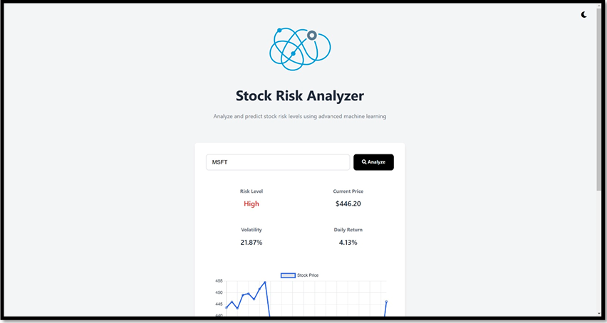
SCREENSHOTS

Slide 23
THANK YOU

